Slide 1


“Driver Drowsiness Detection System”
Sinhgad College of Engineering Department of Information Technology
Project based seminar prepared by:-
Sul Supriya U B150238632
Sawale Ketan A B150238618
Jagtap Samruddhi V B150238551
Rathod Roshnee K B150238607
Kamble Suraj H B150238560
Project Guide - Prof. Shweta Patil
Sinhgad College Of Engineering
1

Slide 2
Contents
Introduction to driver drowsiness system
HAAR Algorithm
Movement measurement methods
Methods for Measuring Drowsiness
Presuming Driver's Drowsiness by Eye-Blinks coping with Individual Differences
Block diagram
Flow chart
System Implementation
Applications
Advantages
Conclusion
References
Sinhgad College Of Engineering

Slide 3
Problem Statement / Motivation-objective
Aim- Avoid road accidents due to driver drowsiness
Introduction- Nowadays the driver safety in the car is one of the most wanted system to avoid accidents. Our objective of the project is to ensure the safety system. For enhancing the safety, we are detecting the eye blinks of the driver and estimating the driver status and control the car accordingly.
Objective a. Avoid road accidents
b. Decrease death rate on road
c. Saves human life
Sinhgad College Of Engineering

Slide 4
Literature Survey/Related work
Sr. No. | Reference Name (Write Paper Title) | Work description | Problems found
1 | IEEE 2020 DrowsyDet: A Mobile Application for Real-time Driver Drowsiness Detection https://ieeexplore.ieee.org/document/9060375 | Monitor on Driver Using Mobile phones camera | Less time to Monitoring cause of depends on the phone battery
2 | IEEE 2020 Driver Drowsiness Detection Percentage Eye closure method https://ieeexplore.ieee.org/abstract/document/9182059 | Detects Eye-Blink based on different scenarios | Doesn’t detect Eye when person wears Eye glasses
3 | IEEE 2020 Driver Fatigue Detection https://ieeexplore.ieee.org/document/9182237 | It captures every small facial expression | It doesn’t give any alert, only detects drowsiness
4 | IEEE 2017 Driver Drowsiness Detection Using Visual Information on Android Device https://ieeexplore.ieee.org/document/8262582 | Monitors Driver, Lane and speed of the Vehicle | It is compulsory to wear electrode helmet
5 | IEEE 2017 Drowsy Driver Detection System https://ieeexplore.ieee.org/document/8070847 | Driver’s state is detected using iris and pupil color | Detects Drowsiness only on behavioral factor
Sinhgad College Of Engineering

Slide 5
Haar Algorithm
It is then used to detect objects in other images.
A Haar algorithm, or a Haar cascade classifier, is a machine learning object detection program that identifies objects in an image and video.
The algorithm can be explained in four stages:
Calculating Haar Features
Creating Integral Images
Using Adaboost
Implementing Cascading Classifiers
Sinhgad College Of Engineering

Slide 6
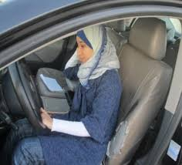
Methods for movement measurement
1) Head movement measures To detect the driver’s state based on his/her head movement. For this, driver’s head movements during normal and drowsy driving need to be compared and analyzed.
Sinhgad College Of Engineering

Slide 7
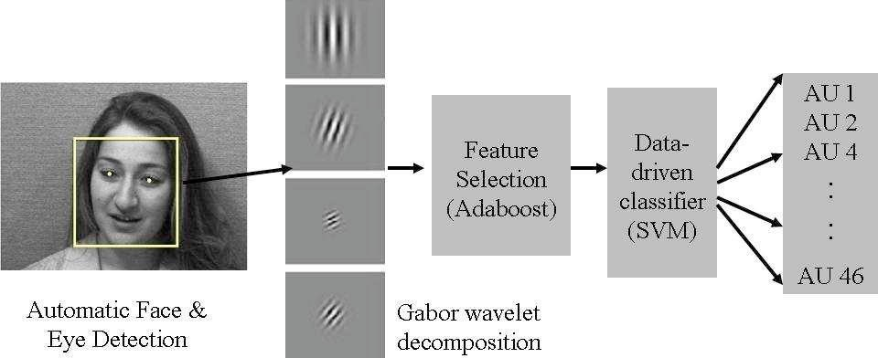
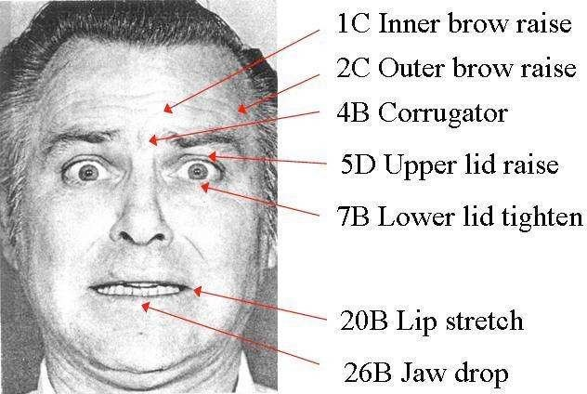
2. Facial Action Classifiers Used for coding facial expressions in the behavioral sciences
Sinhgad College Of Engineering
Fig.1 facial action decomposition from Facial Action Coding System
Fig.2 Overview of fully automated facial action coding system.

Slide 8
Method for Measuring Drowsiness
Behavioral Measure:
The behavior of the driver, including yawning, eye closure, eye blinking, head pose is monitored through a camera and the driver is alerted if any of these drowsiness symptoms are detected.
A drowsy person displays a number of characteristic facial movements, including rapid and constant blinking, nodding or swinging his head and frequent yawning
Computerized, behavioral approaches are widely used for determining the drowsiness level of drivers by measuring their abnormal behaviors.
Sinhgad College Of Engineering

Slide 9
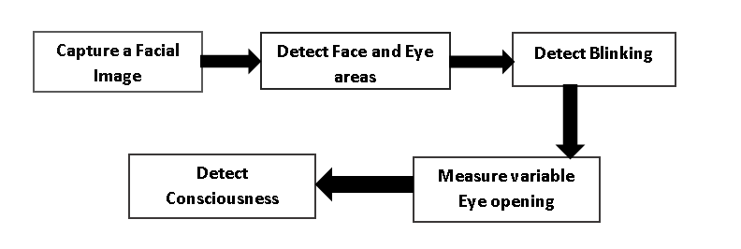
Method for Presuming Driver's Drowsiness by Eye-Blinks coping with Individual Differences
The whole system is installed in a car, the system has to be designed so that all the process of the system from acquisition of images to presumption of the driver's status, are able to function on the car actually.
The Procedure for Detecting Driver’s Drowsiness
based on Individual Aspect
Sinhgad College Of Engineering

Slide 10
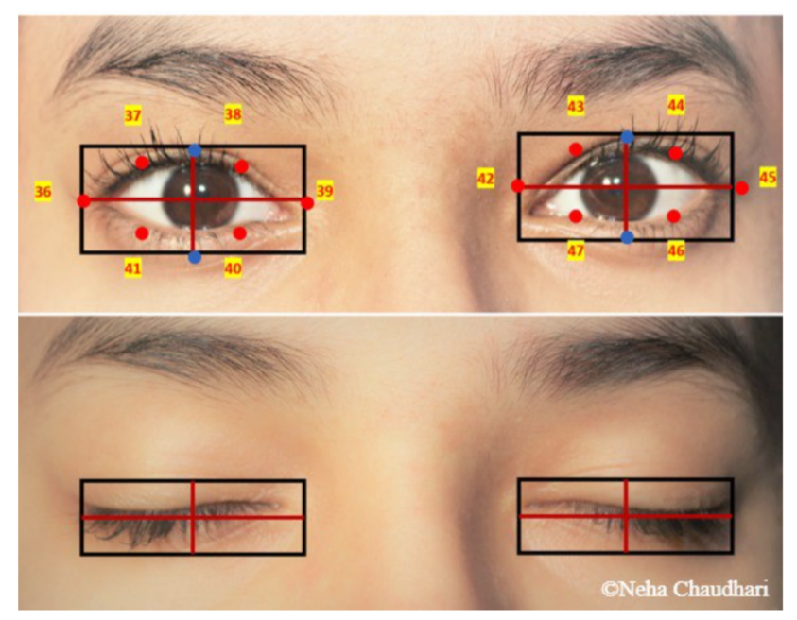
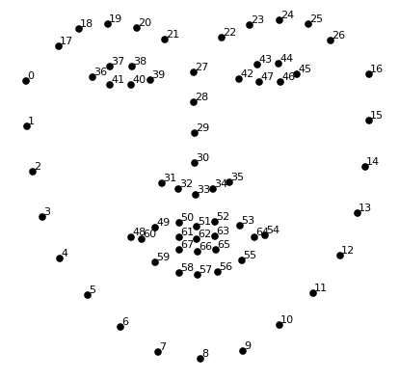
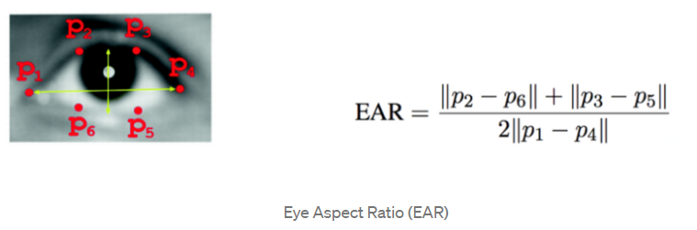
Horizontal & Vertical Length Ratio
Sinhgad College Of Engineering
Facial Landmark from OpenCV

Slide 11
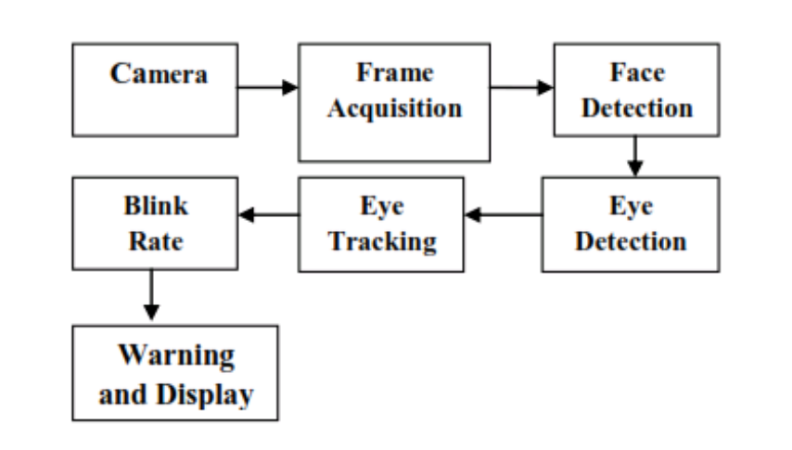
Block Diagram
Sinhgad College Of Engineering

Slide 12
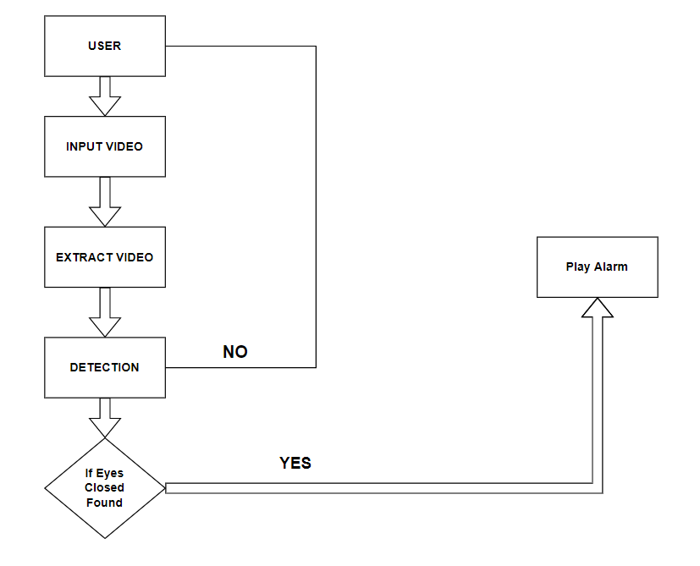
Flow Chart
Sinhgad College Of Engineering

Slide 13
System Implementation
Eye Detection
Drowsiness Detection
Sinhgad College Of Engineering

Slide 14
Applications
This project can be used in the areas where camera as well as use of eyes detection happens .
The working of Driver Drowsiness detection can be used in Airplane, so that pilots can get regular alerts .
If enhanced , the project can be used in online student examination , through which we can prevent cheating as well as can keep eye on the student through giving smart alerts
We are using whole face detection in this project , in the future for security purpose we can use this project .
Make the system work in real-time environment.
Sinhgad College Of Engineering

Slide 15
Advantages
Cost efficient.
More accuracy due to enhanced machine learning algorithm.
Car accidents can be prevented
Can be used in similar areas /domain where it needs a lot
Good detection accuracy is achieved by these techniques
Sinhgad College Of Engineering

Slide 16
Conclusion
Drowsy driving becoming the serious issue In our India where many accidents on highways are happening.
To prevent these accidents , there is the need of system which can alerts us , it should check weather the driver is drowsy or not.
The enhanced system can prevent such road accidents and many lives can be saved.
Sinhgad College Of Engineering

Slide 17
References
Jain, Siddhant. "Drowsiness detection system." (2020).
Sankaran, K. Sakthidasan, N. Vasudevan, and V. Nagarajan. "Driver Drowsiness Detection using Percentage Eye Closure Method." In 2020 International Conference on Communication and Signal Processing (ICCSP), pp. 1422-1425. IEEE, 2020.
Sikander, Gulbadan, and Shahzad Anwar. "Driver fatigue detection systems: A review." IEEE Transactions on Intelligent Transportation Systems 20, no. 6 (2018): 2339-2352.
Riztiane, Aldila, David Habsara Hareva, Dina Stefani, and Samuel Lukas. "Driver drowsiness detection using visual information on android device." In 2017 International Conference on Soft Computing, Intelligent System and Information Technology (ICSIIT), pp. 283-287. IEEE, 2017.
Kumari, BM Kusuma, and P. Ramakanth Kumar. "A survey on drowsy driver detection system." In 2017 International Conference on Big Data Analytics and Computational Intelligence (ICBDAC), pp. 272-279. IEEE, 2017.
Sinhgad College Of Engineering

